Slide 1
Implementation and software
Project#1 (10 points)

Slide 2
Project -1 Description
Find all the possible states of the 8-Puzzle starting from the given initial state. Note that, the states should be unique (no repetitions).
Use the brute force search algorithm (BFS) to find the path to reach the goal state using the possible states of 8-puzzle.
You can use Matlab/C++/Python for programing

Slide 3
Example
Following example shows different configurations of the 8-puzzle generated from the initial state.
From the initial state of the puzzle, use different moves in all the directions to generate new states, check the validity of the newly generated node.

Slide 4
First method

Slide 5
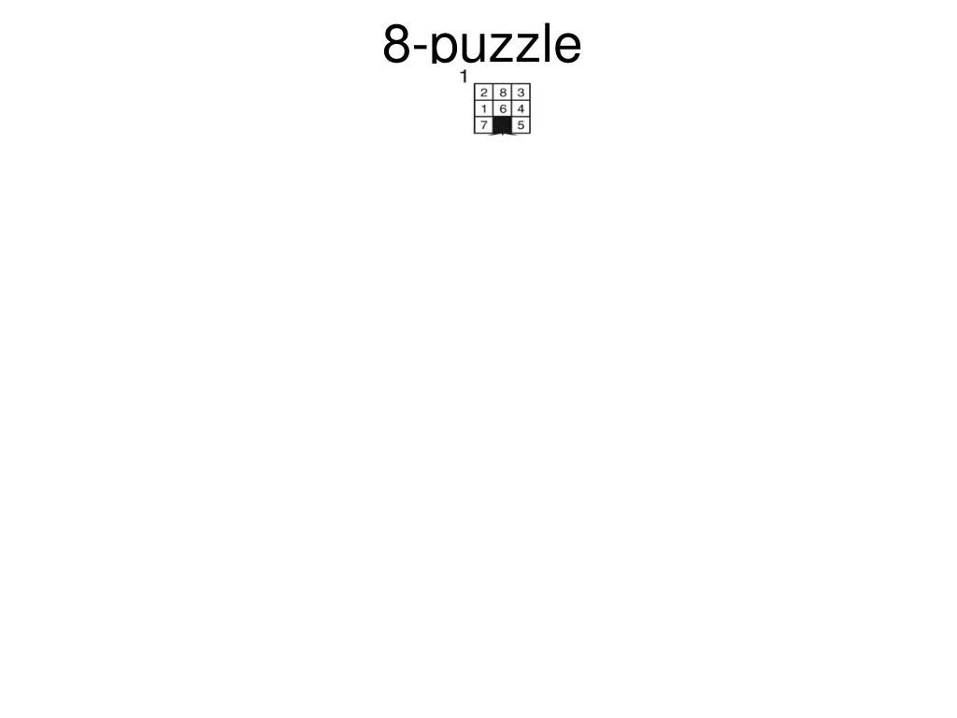

Slide 6
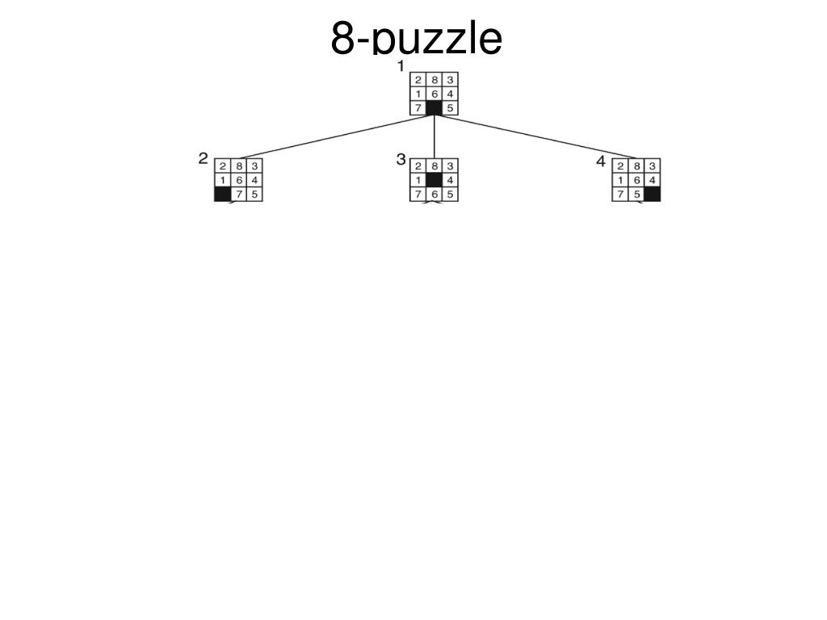

Slide 7
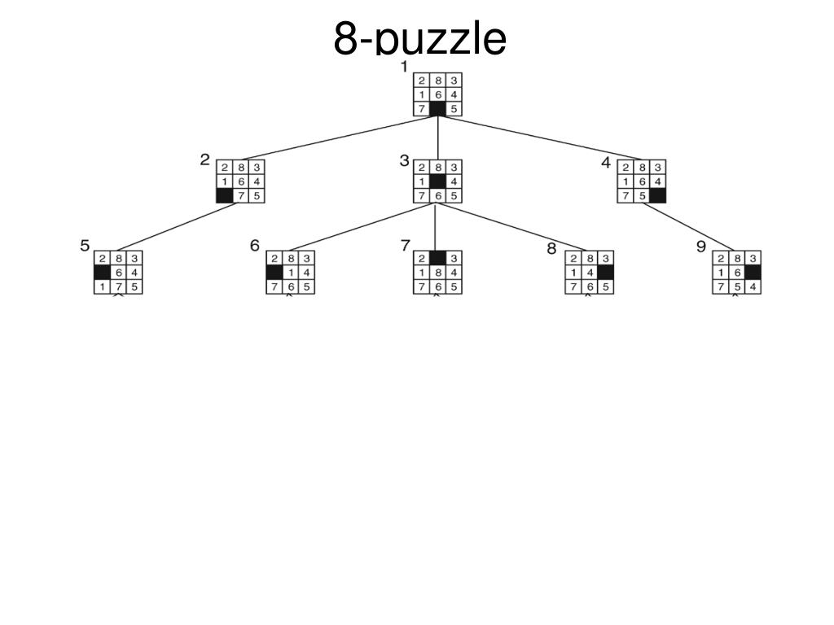

Slide 8
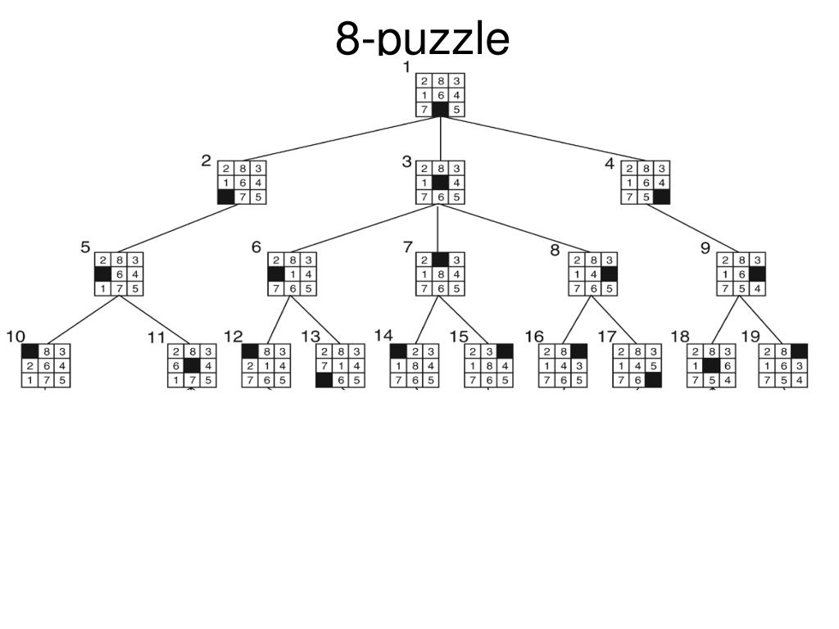

Slide 9
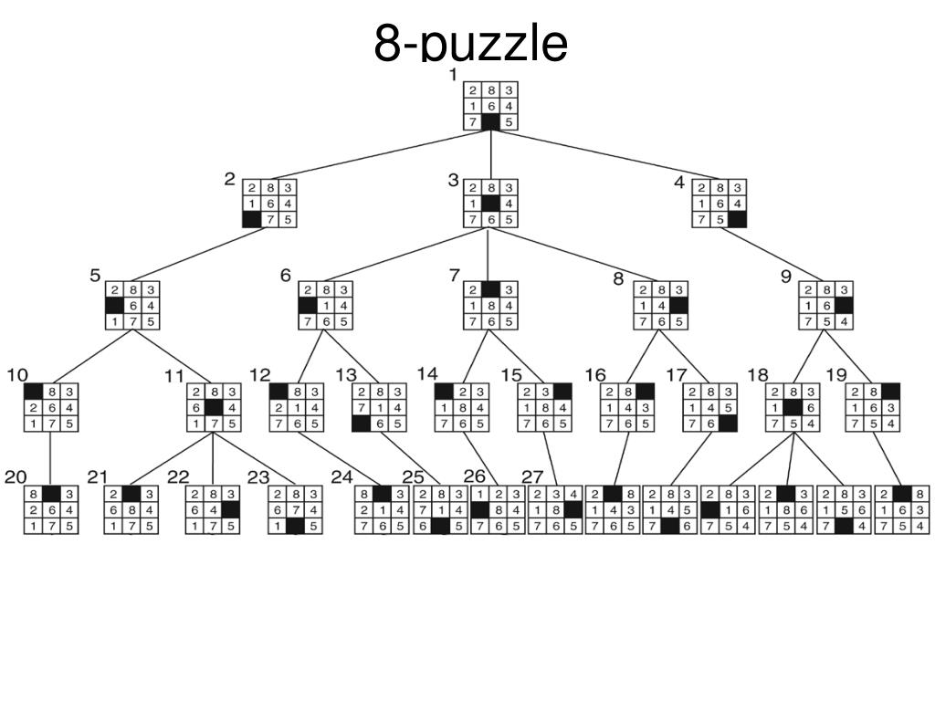

Slide 10
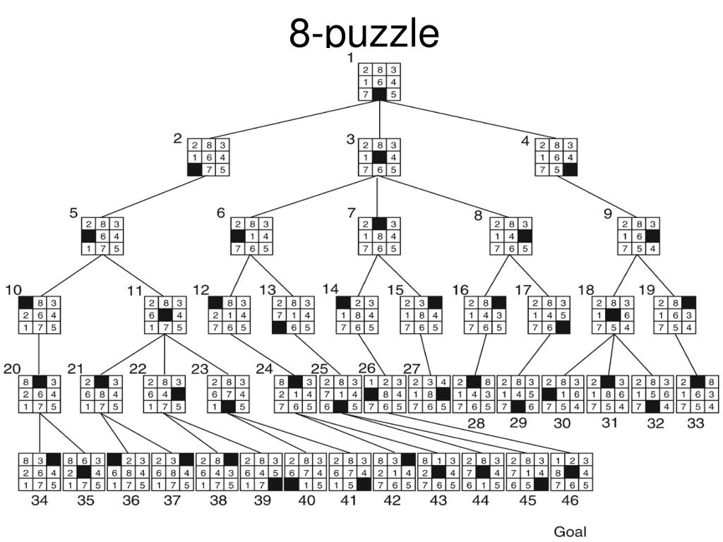

Slide 11
Brute Force search algorithm
In computer science, brute-force search or exhaustive search, also known as generate and test, is a very general problem-solving technique and algorithmic paradigm that consists of systematically enumerating all possible candidates for the solution and checking whether each candidate satisfies the problem's statement.
As you find different states of the 8-puzzle, you will be checking for the goal state.
Once you find the goal state, use the node information to find the parent node. This backward process will finally lead to the initial state.
This algorithm does not consider the cost (number of moves) to reach the goal state.
Ref. - https://en.wikipedia.org/wiki/Brute-force_search

Slide 12
MATLAB
Define Nodes matrix and NodesInfo matrix first:
Nodes= [];
NodesInfo=[]; % NodeInfo = [ Node #, Parent node #, Cost2Come (Number of Steps)]
Nodes_Init = [0 1 3; 4 2 5; 7 8 6]; % Define initial State of the puzzle, input from the user
% For example: Nodes_Init= [0 1 3; 4 2 5; 7 8 6]
NodesInfo_Init = [1 0 0]; % Information matrix for the first node
Nodes_Goal = [1 2 3; 4 5 6; 7 8 0]; % Assume [1 2 3; 4 5 6; 7 8 0] as the goal node
Nodes(:, :, 1) = Nodes_Init; % Save initial state to nodes set
Sub_functions:
[X0 Y0] = BlankTileLocation(CurrentNode); % Find the location of the blank tile
[Status, NewNode] = ActionMoveLeft(CurrentNode); % Moves blank tile left, if possible
[Status, NewNode] = ActionMoveRight(CurrentNode); % Moves blank tile right, if possible
[Status, NewNode] = ActionMoveUp(CurrentNode); % Moves blank tile up, if possible
[Status, NewNode] = ActionMoveDown(CurrentNode); % Moves blank tile down, if possible
[Nodes, NodesInfo] = AddNode(NewNode); % Function also checks whether node is new or not
[Moves] = Goal_Check(NewNode, Nodes_goal); % Gives path from initial to goal state

Slide 13
Additional Points
The MATLAB script to visualize the moves will be provided. To successfully run the script, output of your code must follow the given format.
Nodes is a 3-D matrix where the first two dimension represents individual nodes and the 3rd dimension represents the number of nodes explored.
NodesInfo is a 2-D or a 3-D matrix where the last dimension represents info of different nodes and other dimension gives the node number, parent node number, and the cost-to-come.
nodePath is a 3-D matrix as shown below:
nodePath = cat(3, initial Node,………, goalNode)
sampleNode = [1 2 3; 4 5 6; 0 7 8]; % 0 represents the blank space
Randomly 20-25 students will be selected who need to explain their code during TA office hours.

Slide 14
Due Date and Deliverables
Due date: February 26 , 11:59 p.m
Submit deliverables on Canvas
Deliverables:
Source code
Output matrices : Nodes, NodesInfo and nodePath (the moves to reach the goal state)
A word file that explains how to run the program

